Slide 1

TWITTER API PUBLIC STREAMS
6339 TUTORIAL
BY
NIKITA SATHISH

Slide 2

TWITTER
Free social networking and micro-blogging site
Allows the users to send and receive messages called tweets
The maximum message length is 140 characters
Tweets can be read and sent through twitter website interface or SMS or mobile application

Slide 3

WHY USE TWITTER?
Simple and easy to convey and read messages
Can be used as notice board, feedback forum, discussion ground
Keeps you updated with the topics/ people of your interest

Slide 4

TWITTER USAGE
288 million monthly active users
500 million Tweets are sent per day
80% of Twitter active users are on mobile

Slide 5
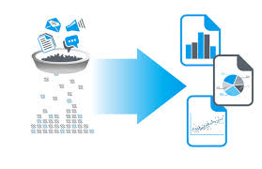
TWITTER IN DATA ANALYSIS
Social network analysis has emerged in the recent years
It helps in analyzing social behavior, cumulating ideas, predicting trends
Due to large number of twitter users, the tweets can be used for this purpose

Slide 6
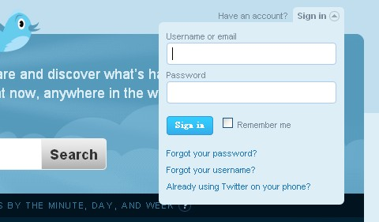
TWITTER LOGIN
Go to: http://twitter.com/
Create account
Settings
Search
Follow
@reply

Slide 7
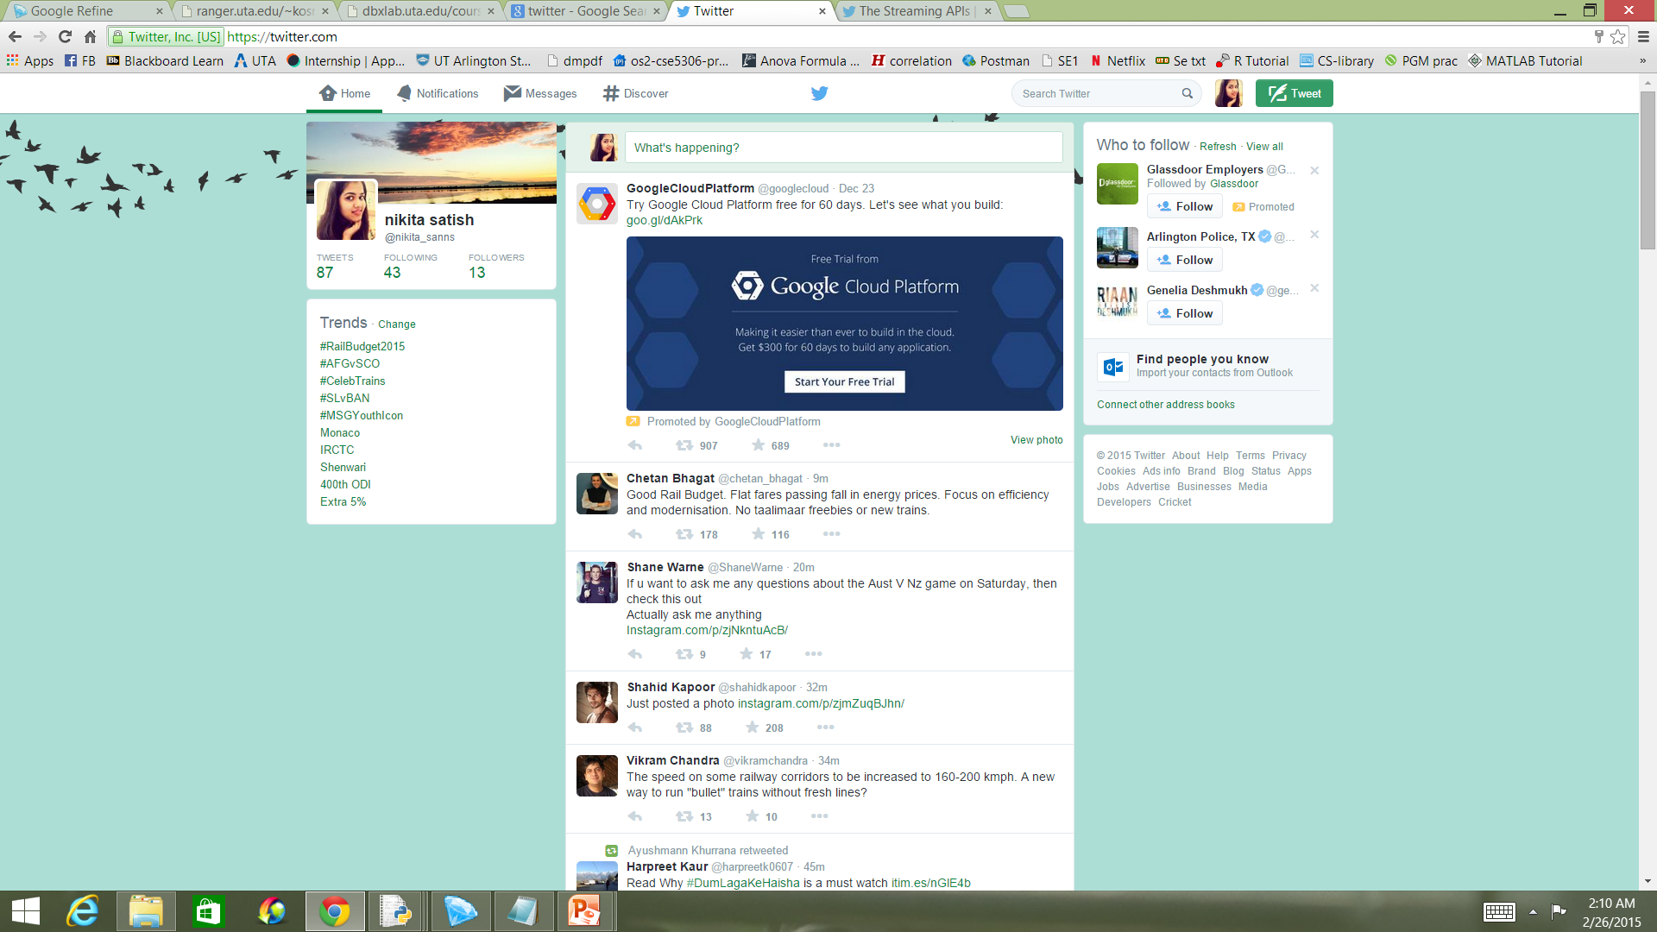
TWITTER API

Slide 8

TWITTER PUBLIC STREAMS
3 endpoints to access public data flowing through twitter
1.POST statuses / filter
2.GET statuses / sample
3.GET statuses / firehose

Slide 9
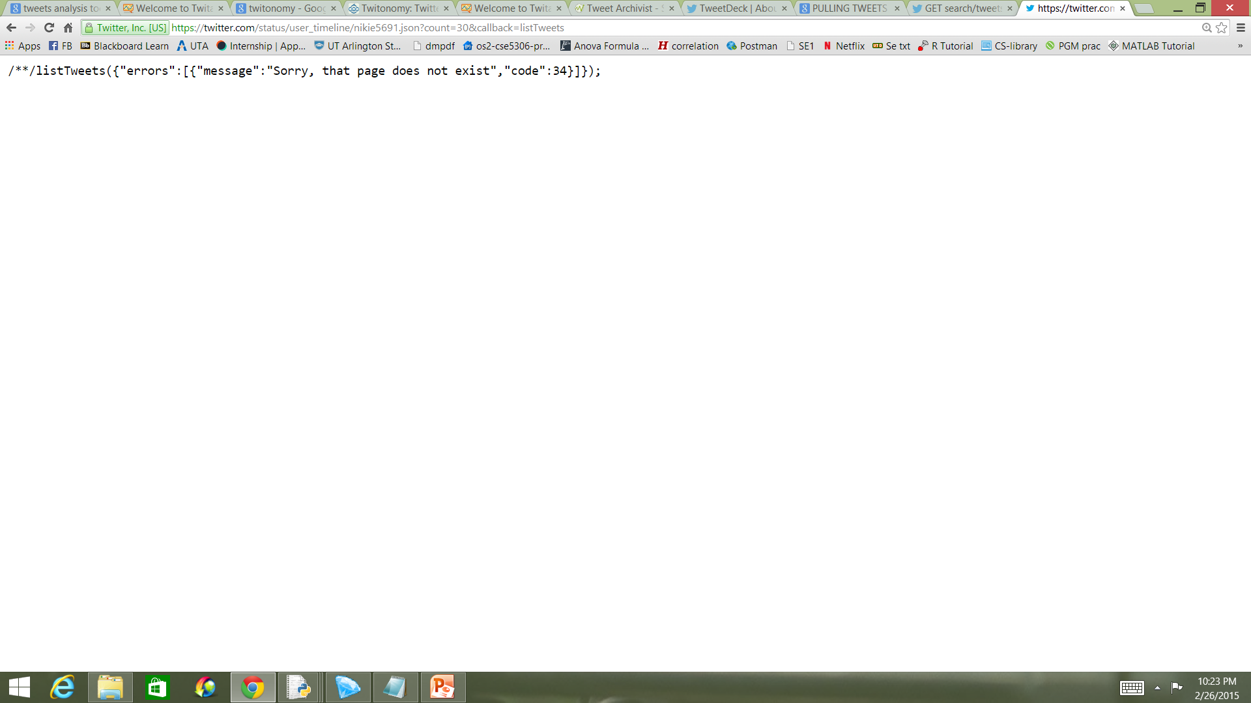
GETTING PUBLIC STREAMS DATA
Earlier way of pulling tweets:
https://twitter.com/status/user_timeline/nikie5691.json?count=30&callback=listTweets
Twitter has removed that facility

Slide 10
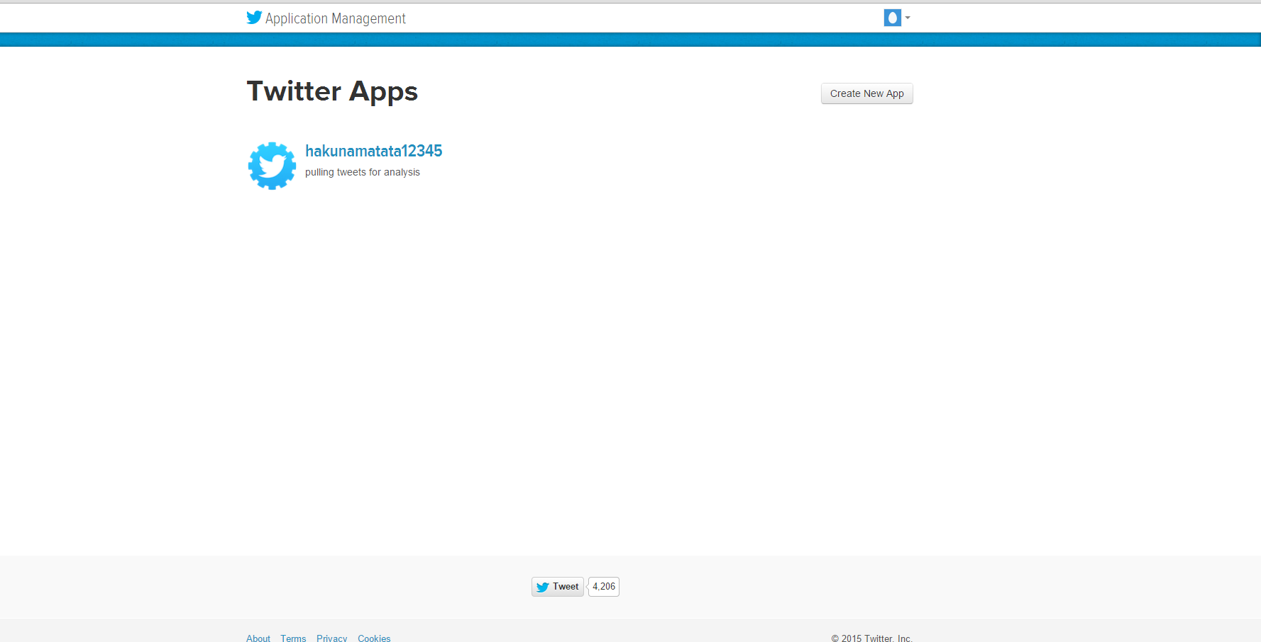
TWITTER FOR APP DEVELOPERS
Go to : https://apps.twitter.com/
Log in with existing twitter credentials

Slide 11
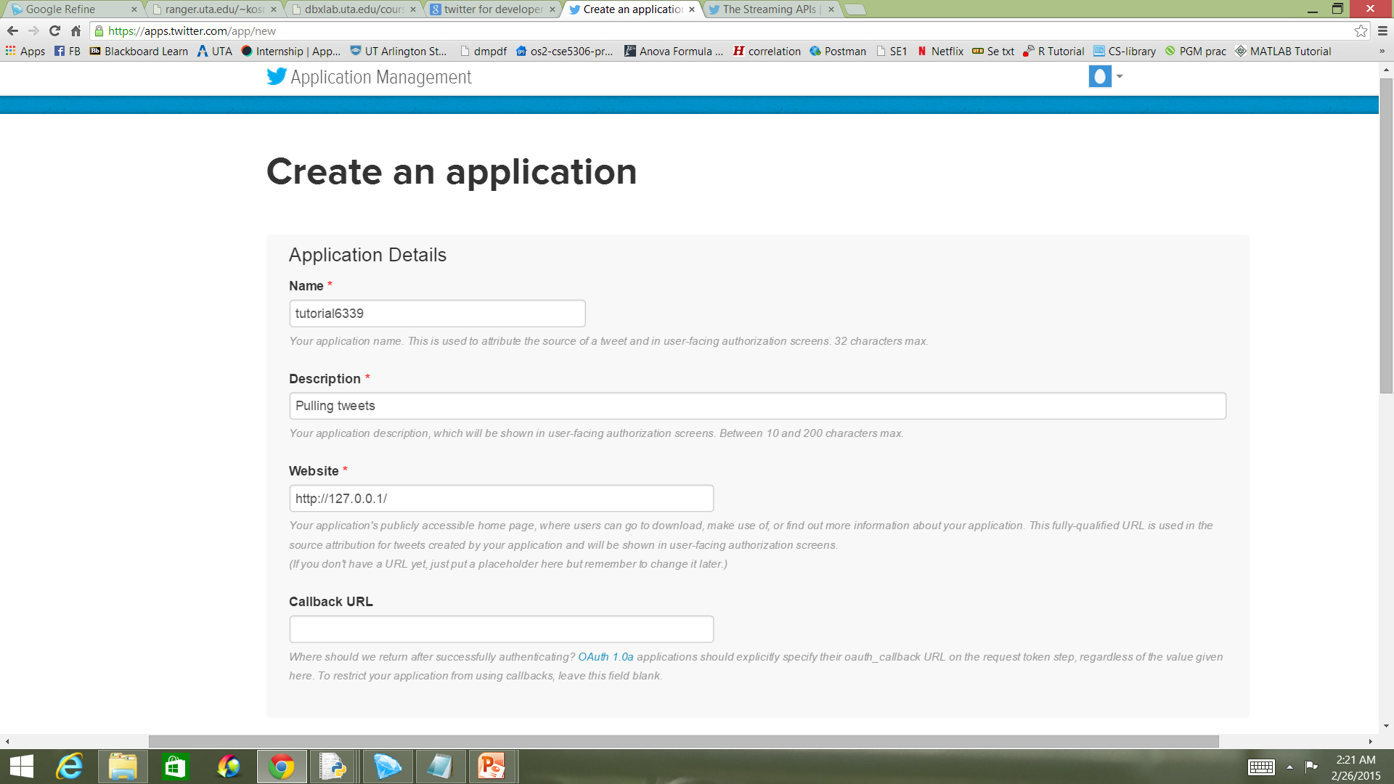
NEW APP CREATION

Slide 12
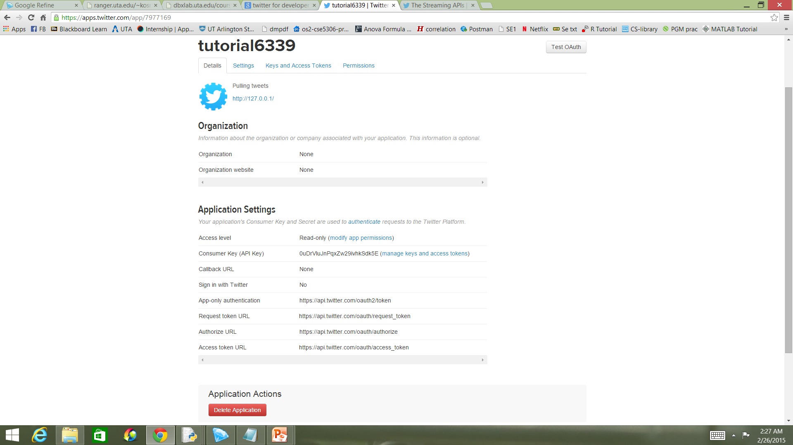
AUTHENTICATION

Slide 13
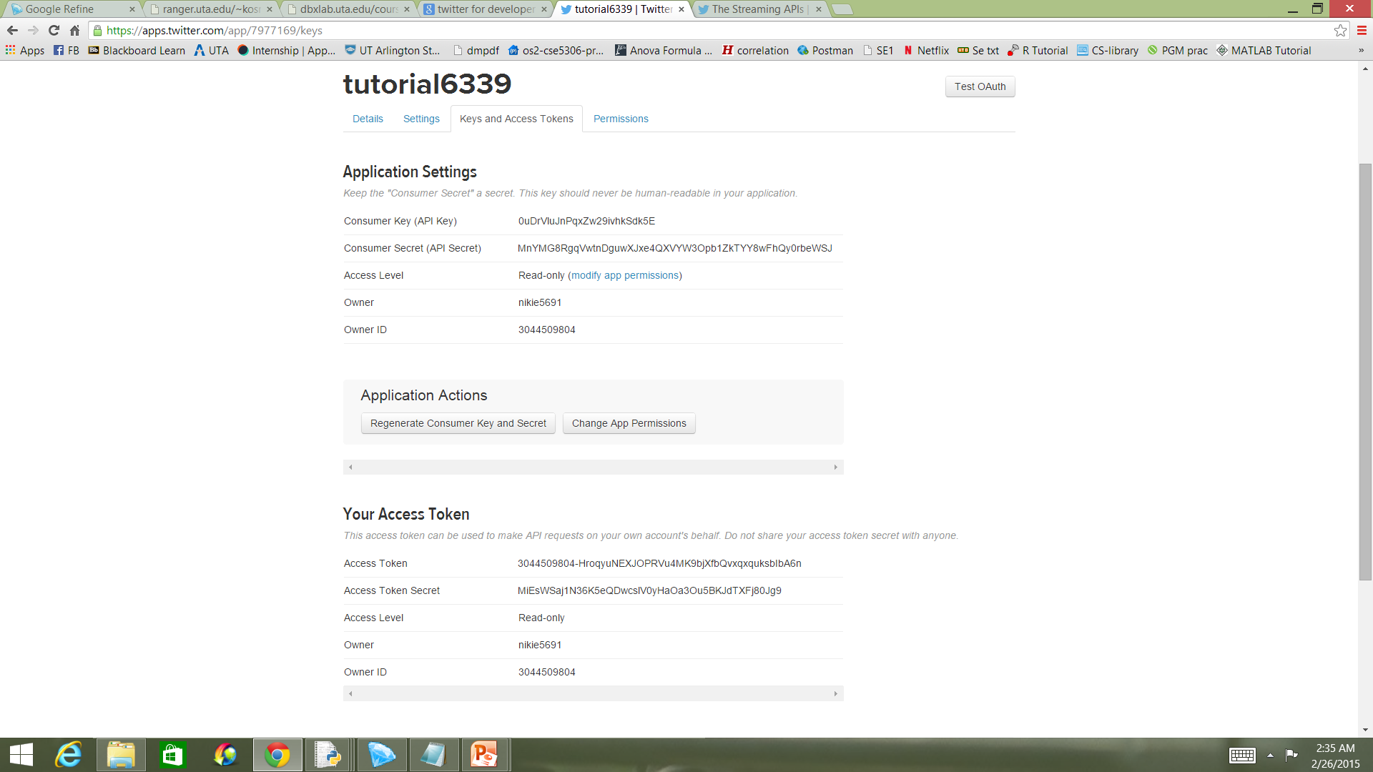
KEYS AND ACCESS TOKENS

Slide 14
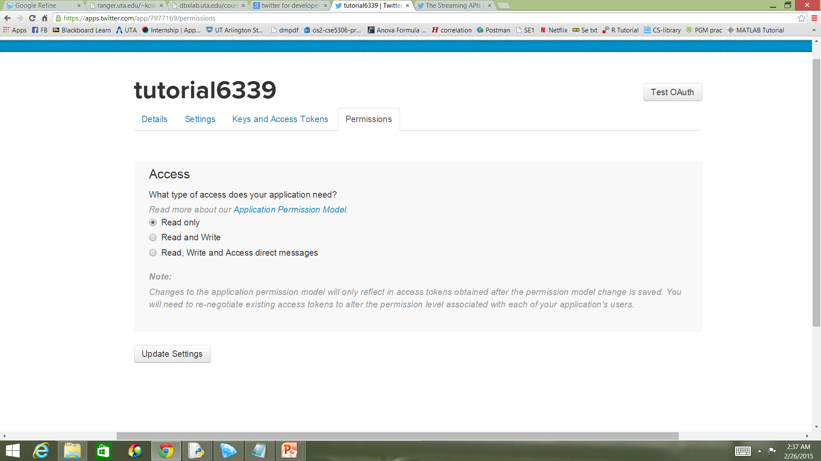
PERMISSIONS

Slide 15
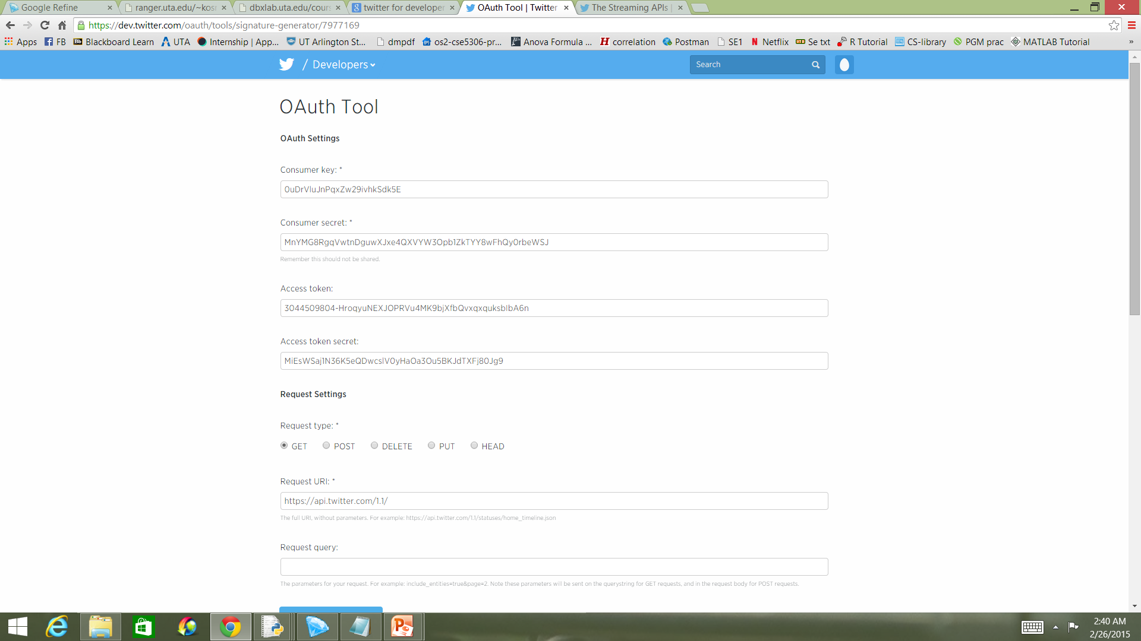
AUTHENTICATION TOOL

Slide 16
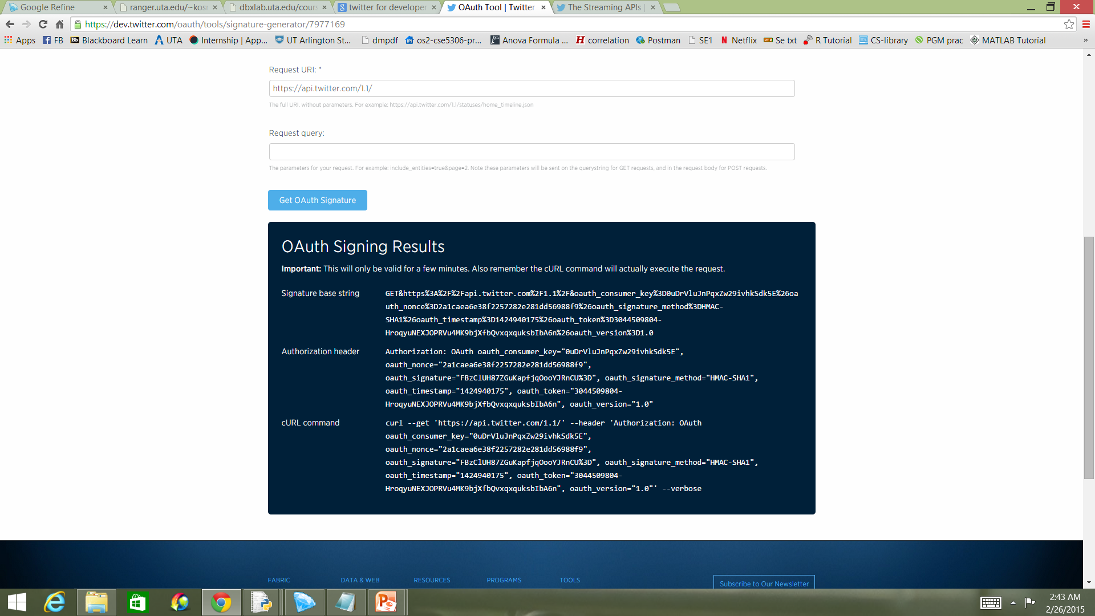
AUTHENTICATION SIGNATURE

Slide 17

TWEEPY
Python library to communicate with twitter platform and helps access its API
Open sourced
Hosted on GitHub

Slide 18
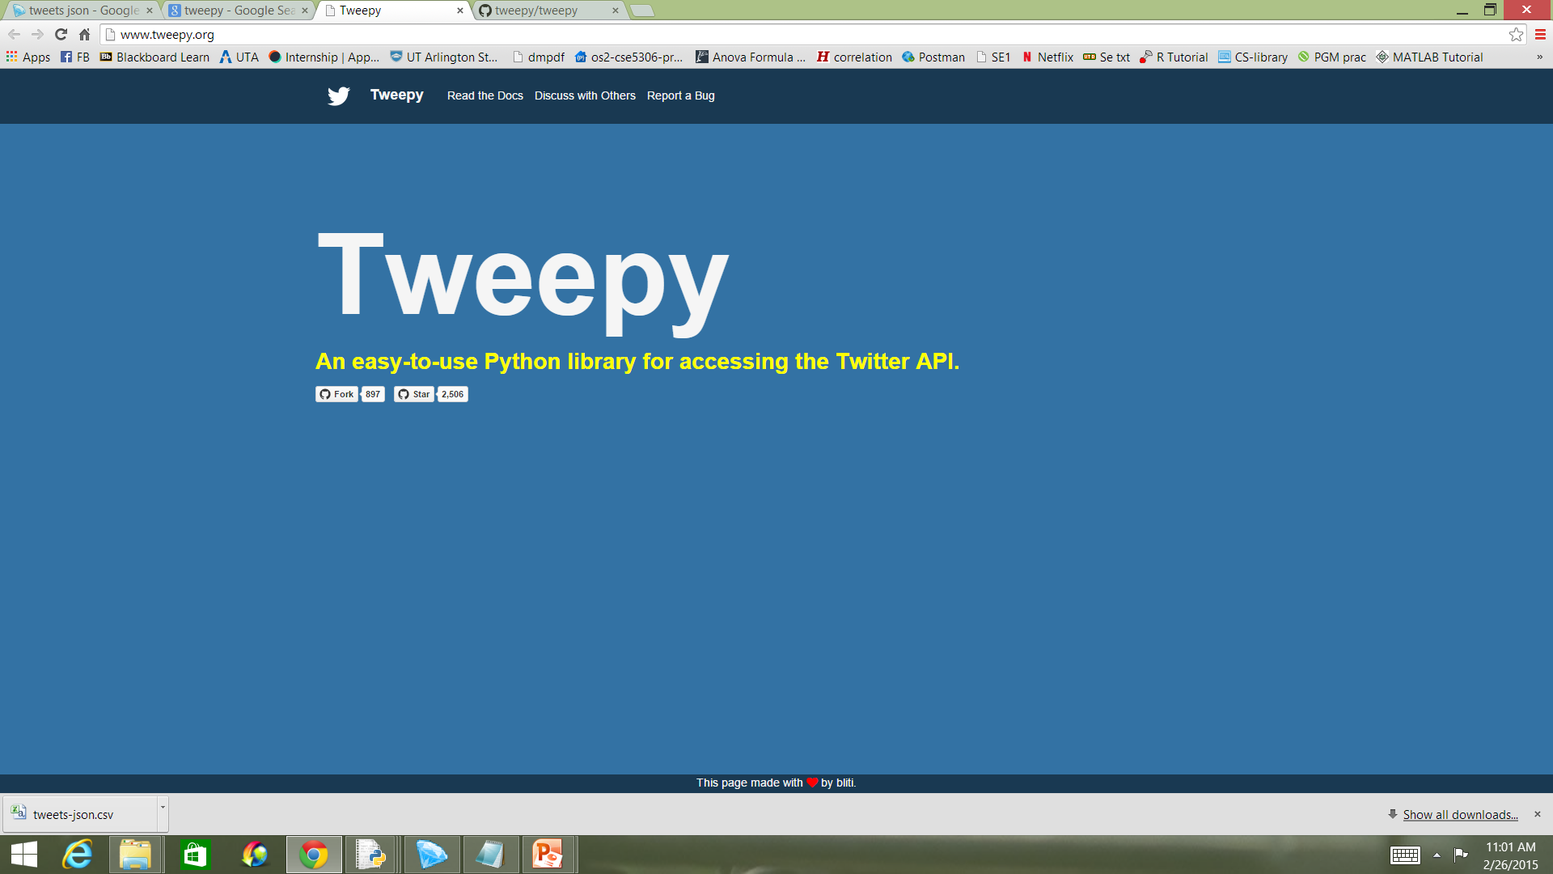
TWEEPY
Go to : http://www.tweepy.org/

Slide 19
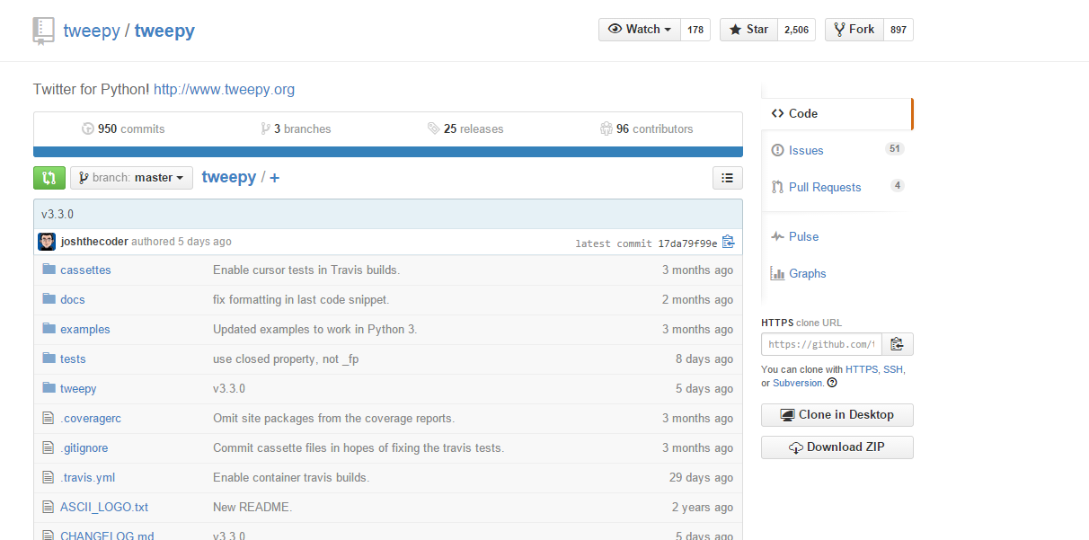
TWEEPY DOWNLOAD
Click on star GitHub link
Login to your GitHub account
Download the zip file

Slide 20
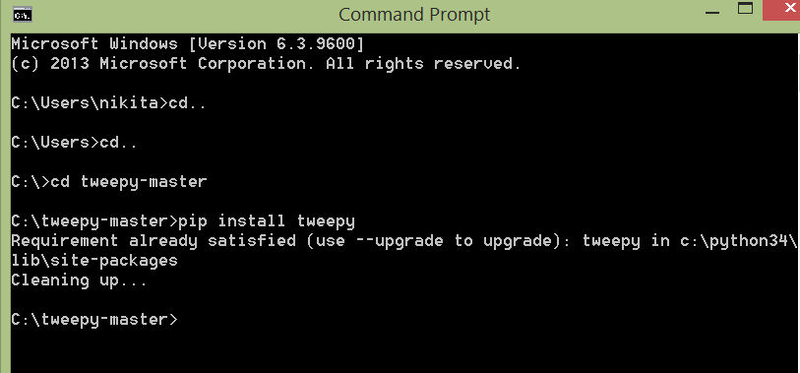
TWEEPY INSTALL
Open command prompt
Change the current working directory to tweepy-master
Run pip install command to install pip

Slide 21
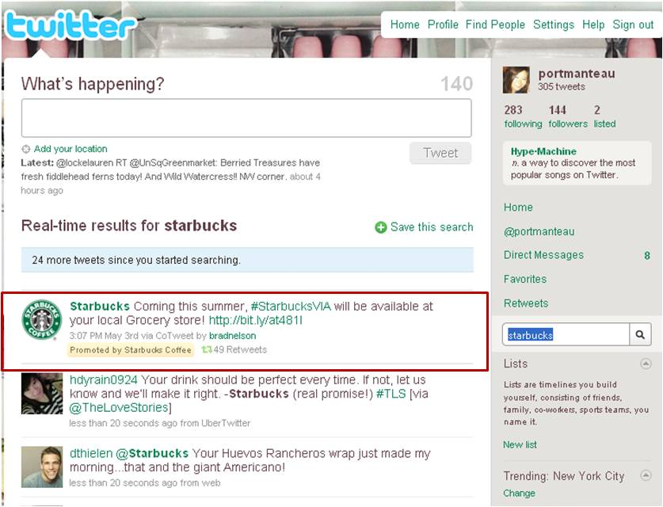
TWEETS
Public streaming tweets
On your timeline
Specific to a topic
Specific to a person
Specific to a location

Slide 22
PULLING TWEETS
Script to pull tweets from your timeline
import tweepy
consumer_key='HZodeLCDcNFh3xlr0LIinU7BW'
consumer_secret='LNPDrDMQAsmkWmH69ryj8dlsxZcT5fwDwvuFsRdBEHpTbb6itz'
access_token='3044509804-LhQhoySGLv92NOZM8xWrUnc6KqjAcyMlQ1tvP9F'
access_token_secret='x2Ls3vycDptwBwaLhLwUEGe2PssQa6cvwiYMkUKOu3is2'
auth = tweepy.OAuthHandler(consumer_key, consumer_secret)
auth.set_access_token(access_token, access_token_secret)
api = tweepy.API(auth)
public_tweets = api.home_timeline()
for tweet in public_tweets:
print(tweet.text)

Slide 23
PULLING TWEETS
Script to pull tweets randomly
from tweepy import Stream
from tweepy import OAuthHandler
from tweepy.streaming import StreamListener
consumer_key='HZodeLCDcNFh3xlr0LIinU7BW'
consumer_secret='LNPDrDMQAsmkWmH69ryj8dlsxZcT5fwDwvuFsRdBEHpTbb6itz'
access_token='3044509804-LhQhoySGLv92NOZM8xWrUnc6KqjAcyMlQ1tvP9F'
access_token_secret='x2Ls3vycDptwBwaLhLwUEGe2PssQa6cvwiYMkUKOu3is2'
class listener(StreamListener):
def on_data(self,data):
print(data)
return True
def on_error(self,status):
print(status)
auth=OAuthHandler(consumer_key,consumer_secret)
auth.set_access_token(access_token,access_token_secret)
twitterStream=Stream(auth,listener())
twitterStream.filter(track=['@ICC'])

Slide 24
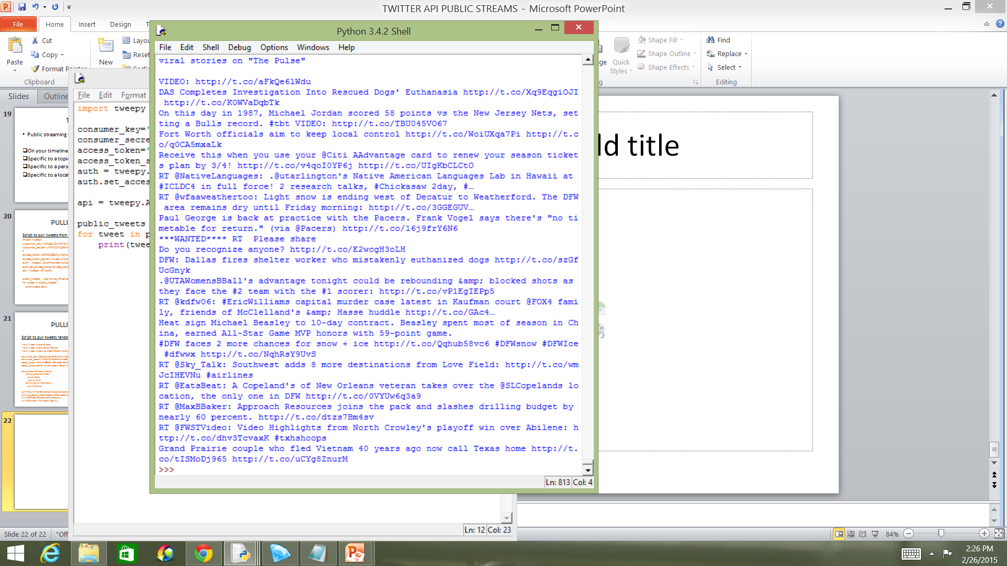
OUTPUT
Tweets in JSON format

Slide 25

TWEET ANALYSIS
Many applications are developed in twitter for the analysis of tweets. For Eg:
1.Tweetreach
2.Tweet Archivist
3.TweetDeck
4. Twitalyzer
5. Twitonomy

Slide 26

TWEETREACH
Tweetreach
Go to : https://tweetreach.com/products/snapshots/
Enter keyword/username/hashtag of interest in the text box provided
You can see a snapshot that depicts information such as estimated reach, top contributors, most retweets related to your topic of interest

Slide 27
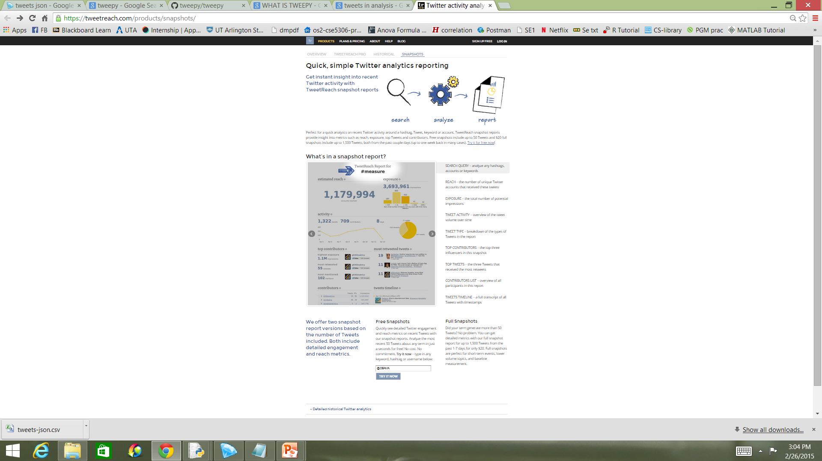
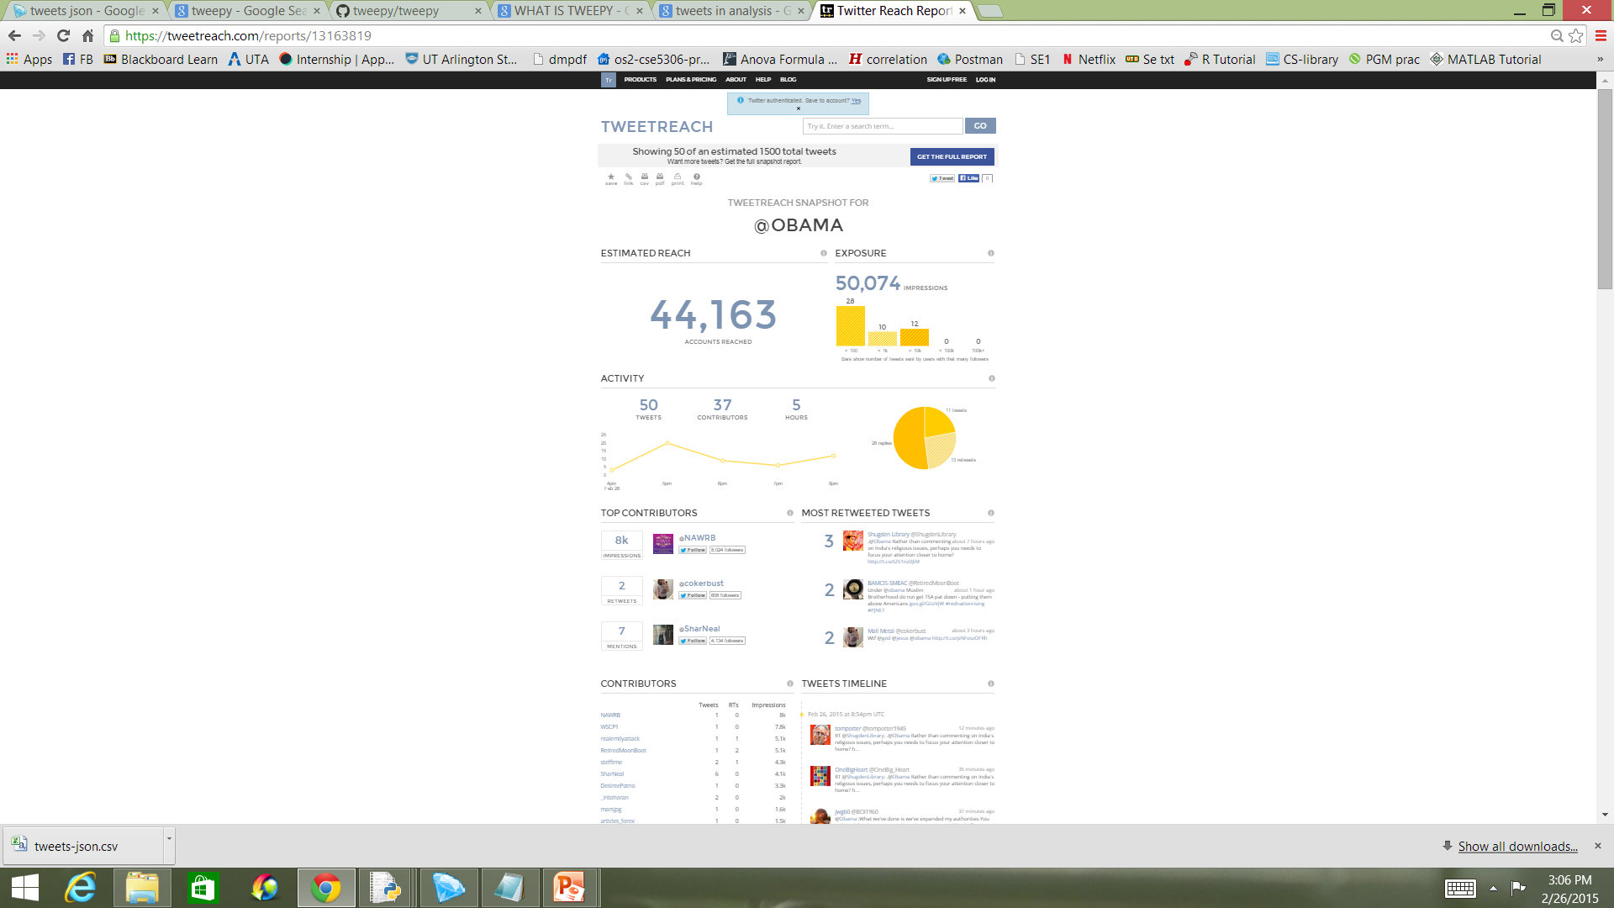
TWEETREACH

Slide 28
REFERENCES
https://dev.twitter.com/streaming/public
https://bcomposes.wordpress.com/2013/01/25/a-walk-through-for-the-twitter-streaming-api/
http://www.twitalyzer.com/5/index.asp
http://www.twitonomy.com/
https://www.tweetarchivist.com/
https://about.twitter.com/products/tweetdeck

Slide 29

Q & A

Slide 30


